Slide 2
Architecture Overview
Ignite – World Wide Tour
Microsoft Corporation

Slide 3
Agenda
Changes to Server Farm Architecture
New Architectural Features
New Services Architecture
Server Farm Topology
Project and SharePoint Farm Scenarios
Deployment
Overview of changes
Hardware & Software
Post Setup

Slide 4
Changes to Server Farm Architecture

Slide 5
Major Changes
Available in 64 bit only (server)
Only supported on 64 bit version of Windows 2008 Server as the operating system
Only supported on 64 bit SQL Server as the database server
Internet Explorer 7.0 and higher for Project Web Access (PWA) (no third party browser support in PWA)
Dependency on the SharePoint Server 2010 Enterprise (no longer installable on top of Windows SharePoint Services/SharePoint Foundation)
New Services Application architecture
Notes:
Project Server 2010 is only available in 64-bit.
Project 2010 Professional and Standard editions are available both in 32-bit and 64-bit. 32-bit versions are intended for most users with 64-bit versions being made available to help users that work regularly in more demanding scenarios that tend to require more memory.

Slide 6
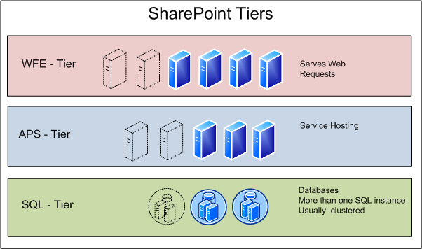
Architectural Components
Web Front End (WFE) – Some changes, some optimization
Application Server – Many changes
SQL – Some changes, heavy optimization
Overall – Major changes
Summing up:
New architecture should feel familiar with some new concepts
2010 is more scalable and flexible than 2007

Slide 7

Web Front End (WFE) Changes
New Client protocol -transports only deltas
Ribbon
Throttling feature to handle peak loads
Memory Optimization - fewer memory issues
Caching Changes

Slide 8

Application Server Changes
New Fault-Tolerant Round-Robin Load Balancing
Enhancements to Timer jobs
Many more services can run on an App Server
Application servers are redundant and can scale-out
Notes:
Enhancements to the SharePoint Server 2010’s services layer benefits Project Server 2010 application servers

Slide 9
Application Server Services
Project Service
Excel Service
Search Service
Visio Service
PerformancePoint Service
And More …
Each Service has its own database now

Slide 10
New Architectural features

Slide 11
What Is New
SharePoint Server Enterprise 2010 has to be installed on every server
PSI includes WCF and ASMX for web services
Project Server Workflow Platform integrated in Application Server
Outlook Addin replaced with Exchange Server integration
New services application model and timer job affinity allows server “grouping” for scalability
64 bit server versions only
Extensive performance and reliability testing
CLR implementation
Notes:
Key Message: The increased scalability of SharePoint Server 2010, upon which Project Server 2010 operates is due primarily to these new features.

Slide 12
32-bit and 64-bit Desktop Project
Enable Larger Programs using more memory ( x64)
Program
Project 1
Project 2
Project n
…
Faster Operations (x64 and x86)
Check out
Calc
Save
Publish
Open
Close
Check in
Notes:
Feature Information
Disposition: New | Improved
Affects: Pro | Std | PWA | Srv
Background
Today, the 32-bit Professional and Standard is constrained by 2Mb of virtual address space which hampers the ability to handle very large programs and overall performance of common operations
Description 64-bit is implemented across the stack meaning Project Standard, Professional and Project Server which now integrates Portfolio Server
Offering 64-bit compatibility for Project Standard and Professional will provide customers with performance improvements, which will be especially attractive for customers that create very large and complex master projects
Portfolio Server by virtue of being incorporated into Project Server 2010 will inherit 64-bit compatibility
Performance work done in Project 2010 has been applied to both the x64 and x86 version so both 32-bit and 64-bit clients benefit from the R&D investment that Microsoft has made for the Project 2010 release.
The 64-bit client provides customers will the ability to take better advantage of more powerful desktop machines that have more memory on them so that larger project files may be operated upon.
Benefits
Portfolio capabilities of the EPM solution can be deployed in a 64-bit environment
Program managers will have Professional and Standard memory resources that can handle large master projects with a huge amount of dependent sub-projects
Client scalability: the significant amount of memory handling headroom can handle large, complex master projects like those in in aerospace and manufacturing
12

Slide 13
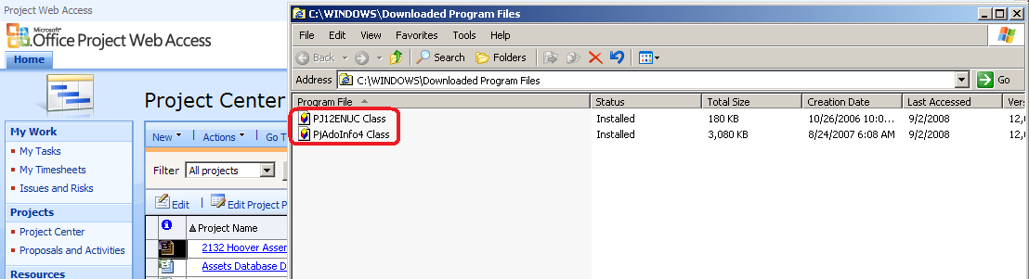
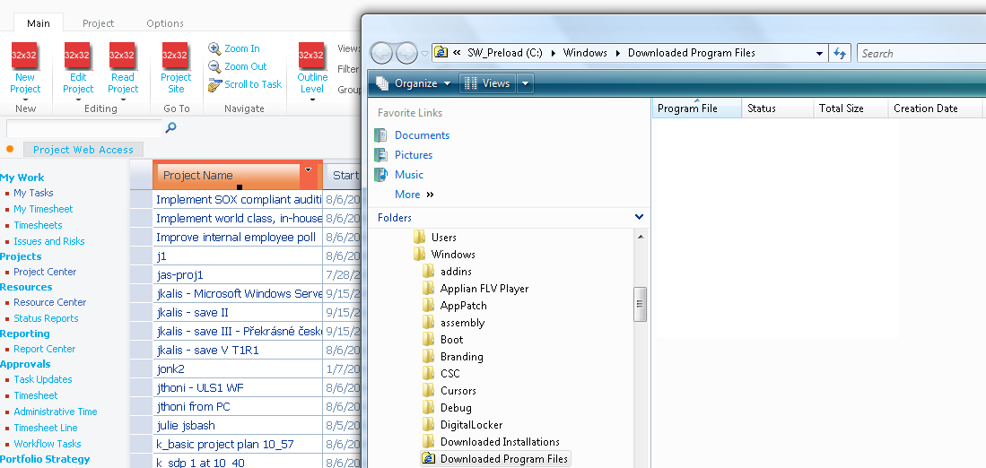
Elimination of ActiveX
Full-featured grid control with zero Professional and Standard footprint
PWA 2007
No more ActiveX
PWA 2010
Notes:
Feature Information
Disposition: New | Improved
Affects: Pro | Std | PWA | Srv
Background
Today’s PWA implementation raises (unfounded) security concerns for unsigned ActiveX controls especially by highly sensitive implementations (i.e. intelligence agencies). Packaging/re-packaging components for client distribution (i.e. cost of deployment) represents a cost of integration.
Description
In the next version we aim to remove all ActiveX controls in Project Web Access and the Portfolio Optimizer module. The main investments will include the creation of a new AJAX Grid, Gantt View, and enhanced reporting infrastructure
The removal of ActiveX controls will improve security, and allow us to deploy to customers that block client-side controls in their environments and that have non-Windows users (i.e. hosted versus on-premise)
Ajax grid - A JavaScript grid control that supports read/write operation replacing the Active X, the Windows SharePoint Services (WSS) Gantt and the WSS DataGrid
Benefits
No installation: unlike ActiveX controls, the Ajax grid control does not require client-side installation
Faster: Ajax controls processes user requests immediately unlike full page loading with HTTP
Richer: cell validation, rich color palette, an interactive grid with field-chooser
FAQ
Q: Level 2 browser support? Safari? Firefox?
A: No IE only
13

Slide 14


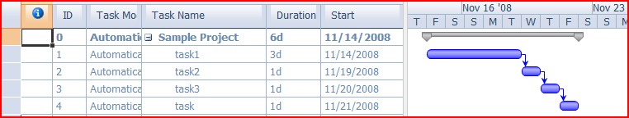
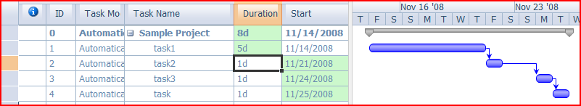

JavaScript Grid
Multi Level Undo
Change Highlighting
Notes:
Change Key API, server can respond with “effects of the change”
This slide highlights the R&D investment made by Microsoft into Project Server 2010 in bringing some of the rich UI experience of the desktop Project client to the Project Web Access 2010 server-based UI via JavaScript.

Slide 15
Deprecations and Enhancements
Project 2007 | Project 2010
ActiveX in Project Web Access | ActiveX replaced by JSGrid control in majority of the scenarios, that no longer requires local installation nor administrative privileges to install.
Office Web Components (OWC) | All OLAP reports by default rendered by Excel Services - a powerful foundation for rich reporting. Reporting views are not upgraded.
Project Proposals and Activities | Converted to “regular” projects with workflow enabled demand management.
Outlook Add-in | Built-in Project Server to Exchange Server Integration

Slide 16
Windows Communications Foundation
Improve overall Performance and Scale
WCF integrated into Project Server 2010
WCF working Side-by-Side with current Web Services (PSI)
Provide infrastructure for Project 2010 and future Project Server enhancements
WCF endpoints include a URL and a binding to specify protocol, security , message encoding and timeouts
Notes:
WCF = Windows Communications Foundation
More information on WCF usage in Project Server 2010 may be found in the Microsoft Project 2010 SDK help file

Slide 17
Project Server 2010’s WCF Implementation
Same Functionality as the Project Server Interface (PSI)
Built on the same business objects
Point to different (single) URL
Allow direct access to the application server
Auto configuration between Project Server 2010 web front end (WFE) and application server (APP)
Available in Technical Preview and Public Beta
Notes:
WCF = Windows Communications Foundation

Slide 18
Project Server Architecture Overview
3rd Party Application
Project Professional
IE
WCF Forwarder
Web Service
Forwarder
Project Web Access
SharePoint
3rd Party Application
WFE
Web Services
WCF Service
SharePoint
Events
Business Objects
Queue
App Server
Data Access Layer (DAL)
MS SQL
Draft
Publish
Reporting
Archive
Content
Config

Slide 19
Portfolio Server Integration
Provides unified experience
Centralize & simplify administration
Single programming interface ( PSI )
Integrated reporting - all in Project Server Reporting Database
Eliminates need for Project Server Gateway
Notes:
By building functionality of previous versions of Portfolio Server into Project Server 2010, Microsoft is providing a single server with project and portfolio management capabilities to improve user experiences by:
Providing a consistent user interface (SharePoint UI) across all modules
Ensuring a Common data repository eliminating the need for the Project Server Gateway
Remove the duplication of functionality between the servers.
Centralize & Simplify Administration
Better support across the entire PPM life cycle.

Slide 20
New Services Architecture

Slide 21
New Service Application Model
SSPs are replaced with Service Applications
A la carte, ‘unboxed’ services
Integrated administration model
3rd party extensibility
And much more … SharePoint Server has nearly 20 services
SSP services split out into Service Applications
User Profiles
Search Service App
Project Service App
Excel Service App
Visio Service App
Business Connectivity Service App
And the new services in SharePoint Server SKUs
SharePoint Server 2007 SSPs upgrade into SharePoint Server 2010 Service Applications

Slide 22
Service Applications Benefits
No longer a separate SSP website
SAs managed via Central Administration
Pick and choose the services you use
If you don’t need a service, don’t add it
Web applications can consume services on an individual basis
Each Web application can use any combination of all available SAs
Service Applications may be organized into groups called Proxy Groups
Deploy multiple instances of the same SA
Just give each one a unique name
Reuse SA instances across multiple Web applications in farm
Notes:
In SharePoint 2007, a separate web site was used to manage the Shared Service Provider (SSP). In SharePoint Server 2010 and hence Project Server 2010, all Service Applications can be managed directly in Central Admin (CA) – doesn’t require a separate site for management purposes.
In the SSP model you traditionally consumed all available services from an SSP or none at all (Excel Services sometimes being an exception). In Project Server 2010 there is more flexibility, so you can pick and choose which Service Applications you want to consume within an individual web app.

Slide 23






Service Model – Architectural View
Service: Actual program (binaries) deployed to servers in farm
Service Machine Instance: Actual instance of the running service binaries on a server
Service Application: Configuration of the service in a farm
Service Application
Service Application Proxy: Reference to the Service Application
Service Proxy
Service Proxy
Service Consumer: Bits that utilize the service’s logic
Web Part, Pages
(Service Consumer)
*.SVC’s, PowerShell Cmdlets
(Service Consumer)

Slide 24
What is a Service?
Serv·ice[sûr'vĭs] –noun
A resource provided to network clients; often provided by more than one server
SharePoint definition
An Application Server tier feature that performs the useful function of providing Data or Processing resources to SharePoint features
Installed on one or more application servers

Slide 25

Service Workflow For a typical service
~~~~~~~~~~~~~
~~~~~~~~~~~~~
Browser
Web Front End Server
Application Server

Slide 26
What is a Service Application?
Service Application: A configured logical instance of a Service
Provides data or computing resources
Exposes administrative interfaces
Uses resources
Service Database
Application Pool
Service Instances: Running physical instance of a service
Contains the configured user accounts the server will run as
Contains connection details for the configured databases utilized by the service
Could be non-SharePoint schema databases … ie: custom DBs

Slide 27
How is a Service Application Used?
Features, such as web parts, on a Web App use Service Applications
Web application ⬄ SA Proxy ⬄ Service Application
A Service Application Proxy connects a Web App to a Service app
Associations determined by administrators, can be changed any time
Connections can be managed individually or in groups (‘Service Application Proxy Group’)

Slide 28
Service Application Proxy
A proxy is a virtual entity that connects Web applications to service applications
Consumers interact with the service via proxies
Installed on the WFE servers
Associated with a service application
Knows how to connect to the service on the app servers via WCF services
Talks to a round-robin load balancer when the service is installed on multiple app servers
Notes:
WFE = Web Front End
When you create a service application, a proxy for the service application is created at the same time.
A proxy is a virtual entity that connects Web applications to service applications.
Proxies for services in the local farm are not created by the administrator, but these appear along with the list of service applications in Central Administration.
Some proxies might include settings that can be modified. For example, if a Web application is connected to multiple instances of the Managed Metadata service, you must indicate which of the proxies is connected to the primary service application which hosts the corporate taxonomy.
Proxy groups are explained in more detail in the next slide.

Slide 29
Service Application Proxy Groups
A proxy group is a group of Service Application proxies that are selected for a web application
By default, all SA proxies are included in the default proxy group
You can remove them from the default group
When you create a web app you can:
select the default proxy group
create a custom proxy group by selecting which SA proxies should be included
Notes:
SA = Service Application
In MOSS 2007 Web apps were tied to bundled services via SSPs
In Windows SharePoint Services (WSS) 4.0 it is a looser association, a web application is able to select from just the service application it needs to fulfill its user requirements – i.e. “a la carte” The Service Application Proxy Groups is what makes this possible.
Web applications group multiple service application proxies into Service Application Proxy Groups
Enables a Web application to be tied to one or more sets of services, or a mix of multiple farm services.
Note that some types of SharePoint 2010 services are capable of sharing their capabilities across server farms. But the project service application for Project Server 2010 does not.
By default, all service applications are included in the default proxy group. You may remove service applications from the default proxy group if needed.
When you create a Web application, you can select the default proxy group, or you can create a custom proxy group by selecting only the service applications that you want the Web application to use.
Custom proxy groups are not reusable across multiple Web applications. Each time you select “custom” when creating a Web application, you are selecting services only for the Web application you are creating.

Slide 30
Service Model – Logical View
Farm 1
Farm 2
Farm 3
Search
User Profiles
Managed Metadata
Search
Excel
User
Profiles
http://hr.contoso.com
http://epm.contoso.com

Slide 31
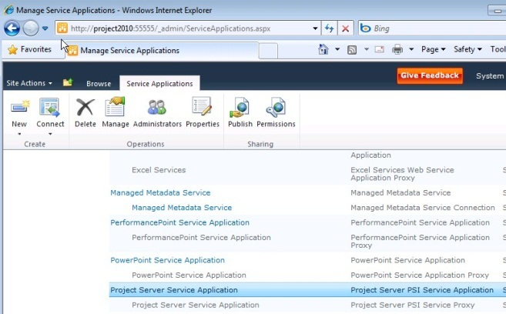
Services Administration
No longer a separate SSP website
SAs managed via Central Administration
Services can be monitored and managed remotely
Services can be managed and scripted by Windows PowerShell
Notes:
Managing Services directly in Central Administration is an improvement on previous versions of SharePoint, where services in an SSP were managed in a separate SSP administration site. Having one UI to manage the SharePoint server farm and its services simplifies the SharePoint administrative experience.

Slide 32
Services Administration
Simplified administration model
Managed via Central admin and PowerShell
A la carte consumption
Increased flexibility in deployment
Fault Tolerant Round-robin Load Balancing
Support for hardware load balancing
Flexible, secure cross-farm federation
Trust-based security
Share to anyone and consume from anywhere
WCF-based web services for communication
No direct DB Access

Slide 33

PowerShell
All Admin operations are PowerShell enabled
Only Farm Admins and Shell Admins can use PowerShell
Use PowerShell to*:
Create and Delete Service Applications
New-SPSearchServiceApplication –name “My Search” –database sql-svr-01\srchdb01 –account “redmond\srchsvc”
Share Service Applications
Publish-SPServiceApplication –name “MSW Search”
Start and Stop Instances
Start-SPServiceInstance –Server app-svr-01 –Service “Microsoft.Excel.ExcelInstance”
Perform Bulk Operations
Get-SPServiceApplication | Get-SPServiceApplicationSecurity|Grant-SPObjectSecurity –UserPrincipal “domain\user” –type “Admin” –Rights “full control”
* Actual syntax may differ in the Beta

Slide 34
Exploring the New Service Model Administration
demo

Slide 35
Security for SharePoint 2010 Applications
Improved security model
Claims based authorization within the farm
Communication via WCF-based web services
Support for SSL/transport security
Application isolation
Each service app uses separate database and optionally, separate app pool
Support for multiple service applications for a service with different accounts and databases
Multi-tenancy
Most services are multi-tenant capable
Application-level security for content isolation

Slide 36
Benefits
Support existing Identity infrastructure
Active Directory
LDAP, SQL
Federation Gateways
Web SSO and Identity Management systems
Enable automatic, secure identity delegation
Supports “no-credential” connections to External web services
Consistent API to develop SharePoint solutions

Slide 37
Identity
What is Identity?
Set of attributes to describe a user such as name, e-mail, age, group membership, etc.
What is a Claim?
Some authority that claims to have the attribute and its value

Slide 38
Sign-in Scenarios
Sign-in to SharePoint with both Windows and LDAP directory Identity
Easily configure Intranet and Extranet users for Collaboration
Integrate with other customer identity systems (eg. ADFS, etc.)
Use Office Applications with non-Windows Authentication

Slide 39
Identity Normalization
Classic
Claims
NT Token Windows Identity
NT Token Windows Identity
ASP.Net (FBA) SAL, LDAP, Custom …
SAML1.1+ ADFS, etc.
SAML Token
Claims Based Identity
SPUser
Notes:
Security Assertion Markup Language (SAML) is an XML-based standard for exchanging authentication and authorization data between security domains, that is, between an identity provider (a producer of assertions) and a service provider (a consumer of assertions). SAML is a product of the OASIS Security Services Technical Committee.
The single most important problem that SAML is trying to solve is the Web Browser Single Sign-On (SSO) problem. Single sign-on solutions are abundant at the intranet level (using cookies, for example) but extending these solutions beyond the intranet has been problematic and has led to the proliferation of non-interoperable proprietary technologies. SAML has become the definitive standard underlying many web Single Sign-On solutions in the enterprise identity management problem space

Slide 40
Sign-in

Slide 41
Server Farm Topology

Slide 42
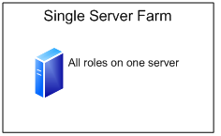
Standard Architectures – Single Server
Single Farm
1 server hosting everything
Purpose
Demos
Development
Proof of Concept/Pilot
Notes:
Key Message: A single service farm is not recommended for production, but it will be a typical choice for demos, development and POC purposes.

Slide 43
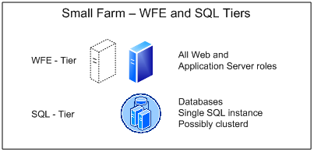
Standard Architectures – Small Farm
Small Farm
1-N WFEs/AppServers
1 SQL
Scalable – simple
Application Servers not isolated from WFE
The simplest and smallest configuration recommended for production environments
Notes:
WFE = Web Front End
Key Message: Small farms are the simplest and smallest configuration recommended for production environments. With the WFE layer being on the same physical machines as the Application Server layer, small farms provide less application isolation compared to larger farm configurations. This may have an impact on the overall reliability and latency of the EPM server farm.

Slide 44
Standard Architectures – Medium Farm
Medium Farm
1-N WFEs
1-N App Servers
1 SQL Instance
Isolating the App Servers onto their own tier consumes more machines, but should provide a more consistent latency for the user.
Notes:
Key Message: Isolating the App Servers onto their own tier will probably consume more machines, but should provide a more consistent latency for the user.

Slide 45
Standard Architectures – Large Farm
Large Farms likely to use Server Groups
Server Group shares same services, load-balancing and configuration
Multiple SQL Instances
Notes:
Key Message: Large farms are likely to leverage multiple SharePoint Server Groups and more physical (or virtual) machines.
Introducing the SharePoint Server Group concept: A set of machines within the server farm with the same set of services, load balancing, and configuration.

Slide 46















Logical Architecture Project Server is a SharePoint Application
Client
Application/PSI Server
Database Server
Microsoft SharePoint Server 2010
Farm Configuration Database
3rd Party Client
http://Svr:32843/ProjectServerApplication/*.asmx
Custom Logic
Impersonation
http://Svr/InstanceName/_vti_bin/psi/*.asmx
Microsoft SharePoint Foundation 2010
Central Admin
Content Database
Windows Workflow Foundation
Project Server
Archive Database(n)
Web Server
Web Service Tier
Business Logic Tier
Server Side
Scheduling
Project Server
Reporting Database(n)
Project Web Access
Microsoft SharePoint Server 2010
ASMX Interface
Queuing
Service
Project Server
Published Database(n)
IE Browser Level
Security Zone
AJAX
Microsoft SharePoint Foundation 2010
Internal Web Services
Project Server
Draft Database(n)
External Web Services
Eventing
Service
Data Access Layer
Filter Data Access Layer
WCF Services
ASMX over http/soap
Business Objects
Web Parts
WCF Interface
Shared Services
Content Database
Project Professional
Serializer
Scheduling Engine
Desktop Reporting
Client Active_Cache
Soap Client
Serializer
Master Pages
Shared Services
Service Database
Project User Context
Workflow Platform
Authentication
ASPX
Web Application
Content Database(n)
Project User Context
PSI Proxies
State Service
Database
WCF Services
PSI Forwarder
Server Active_Cache
PWA and WSS content pages
Web Analytics
Database

Slide 47
Project And SHAREPOINT FARM Scenarios

Slide 48
Deployment Scenarios
Together/Coexistence
Single farm with both Project Server and SharePoint Server
Apart/Standalone
Dedicated Project Server Farm running WSS or SharePoint Server
 | Dedicated Project Server Farm | Dedicated SharePoint Server Farm
Coexistence | Add SharePoint Server | Add Project Server
 | Merge into a single Farm
Standalone | Split Existing Farm into two Farms
EPM and Office SharePoint Server 2007 Coexistence — Intranet Scenario (TechNet whitepaper applicable to 2010)

Slide 49
Sample Architecture Diagram

Slide 50
Together Pros and Cons Single Project and SharePoint Server Farm
Advantages
Server Consolidation
Administration and Maintenance
Single software update plan
Leverage high availability
Disadvantages
Software Updates
Additional training required for SharePoint Administrator(s)
Additional Licenses Required

Slide 51
Apart Pros and Cons Separate Project and SharePoint Server Farm
Advantages
Farm Hardware and Software Updates
No dependency on the Intranet farm’s availability
Change Management
Security Isolation
Leverage the same SQL Server infrastructure as the other Farm
Disadvantages
Additional Administrative Tasks
Applying and testing patches on two farms versus one
Content Management and Governance
Project Server’s SharePoint content cannot be stored on another farm
Greater cost
Additional hardware
Additional software licenses

Slide 52
Deployment Considerations in a Single Farm
Server and Client licenses
Must install Project Server and SharePoint Server on each of your servers
Isolate PS for performance/manageability/ governance purposes
Isolate Project Server content databases and Application Pool
Separate Root Site Collection
Separate Site Collection for Project Workspaces
Isolate Reporting and Online Analytical Processing (OLAP) databases
Patched together (Cumulative Updates/Service Packs) and plan accordingly
Customization
Line Of Business Integration
Outsourcing and farm consolidation

Slide 53
DEPLOYMENT

Slide 54
What’s Changed in Deployment?
SharePoint Server requirement
Move to 64 bit architecture
Project Service Application replaces Shared Service Provider
Configuration of Non-Project Services for core functionality
New required configuration steps

Slide 55
What’s Improved?
Overall Setup experience
Pre-Requisite Installer
Farm Configuration Wizard
Improvements to Central Administration
Manage Project Service with all other Services

Slide 56
Hardware Requirements
All Servers in all Tiers must be 64 bit.
These requirements also apply to Hyper-V
Minimum
Example Project Server Evaluation
4 Gb of RAM
Dual Processor, 2.4 GHz or better
Recommended
8 GB RAM or more
Quad-processor or more will improve performance
Refer to TechNet: Determine hardware and software requirements

Slide 57


Project Server 2010 Software Requirements
SharePoint Server 2010 Enterprise
SQL Server 2005/2008/R2: Standard or Enterprise
Windows Server 2008/R2: Standard, Enterprise, or Data Center Editions
Project Server 2010
Project Professional 2010/2007
Excel 2007/2010
Internet Explorer IE7/IE8
64-bit
Optional
Exchange 2007 SP1 or later
Team Foundation Server 2010 for Application Lifecycle Management
Notes:
SQL 2005 SP3 CU3
SQL 2008 RTM CU4

Slide 58
Language Packs
Public Beta – 7 language packs (download):
German
English
Spanish
French
Japanese
Russian
Chinese (simplified)
Many additional languages will be released when the product is released

Slide 59
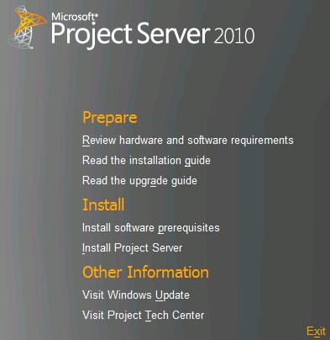
Installation Process
Base Installation
Install Operating System
Run Windows Update
SQL Server
Install SQL Server and Components (Analysis Services, etc…)
Install Software Updates
Sharepoint Server 2010
Run Pre-Requisite Installer
Install Sharepoint Server 2010
Project Server 2010
Post Configuration
Install Project Server
Run SharePoint Configuration Wizard
Central Admin Configuration
Project Web Access Admin Configuration
PowerShell Support

Slide 60

Project Installation
demo

Slide 61
Required Service Applications for Project Server 2010
Minimal Services Required to operate a Project Server 2010 server farm:
Project Service Application
Required to host one or more Project Web Access instances
Reporting
Excel Services
PerformancePoint Service
Support the PWA Report Center. Allows viewing and interactivity with Excel files in a browser for reporting purposes
Secure Store Service
For reporting and data level impersonating
Charting
State Service
Needed to support Project Server 2010 resource availability processes
By default, all available services are enabled by the configuration wizard
Performance Consideration: only enable necessary services to fulfill requirements

Slide 62
Post Setup Project Web Access Core Items
Base Security
Configure Reporting
Excel Services
Secure Store Service
Cube Building Service (Analysis Services OLAP cubes) Time Reporting Periods
Required now for My Tasks/My Timesheets/SEM
Exchange Integration
Project Server users can view Project Server tasks as Outlook tasks without ActiveX
Requires configuration in both Project Server and Exchange Servers

Slide 63
Key Takeaways
SharePoint 2010 platform provides a new, flexible, extensible and scalable services architecture
Admin improvements make managing services easier
New topologies to suit your organizational needs
SharePoint 2010 has a new, flexible, extensible services architecture for middle-tier applications
Administrative improvements make managing services easier through PowerShell and User Interface
Customizable, flexible topologies to suit your organizational needs

Slide 64
Questions?

Slide 65
References
Project 2010 TechCenter on TechNet
http://technet.microsoft.com/en-us/projectserver/ee263909.aspx
SharePoint 2010 related info:
Planning and architecture for SharePoint Server 2010 Beta
http://technet.microsoft.com/en-us/library/cc261834(office.14).aspx
Includes service architecture diagrams at: http://technet.microsoft.com/en-us/library/cc263199(office.14).aspx

Slide 66

© 2009 Microsoft Corporation. All rights reserved. Microsoft, Windows, Windows Vista and other product names are or may be registered trademarks and/or trademarks in the U.S. and/or other countries.
The information herein is for informational purposes only and represents the current view of Microsoft Corporation as of the date of this presentation. Because Microsoft must respond to changing market conditions, it should not be interpreted to be a commitment on the part of Microsoft, and Microsoft cannot guarantee the accuracy of any information provided after the date of this presentation. MICROSOFT MAKES NO WARRANTIES, EXPRESS, IMPLIED OR STATUTORY, AS TO THE INFORMATION IN THIS PRESENTATION.

